Slide 1


Traffic Light - IR Sensor
Group E
Phoenix team

Slide 2

Introduction
These two circuits are training in electronics basics that we learned
1- A single traffic light circuit
2- An IR module using op - Amp

Slide 3
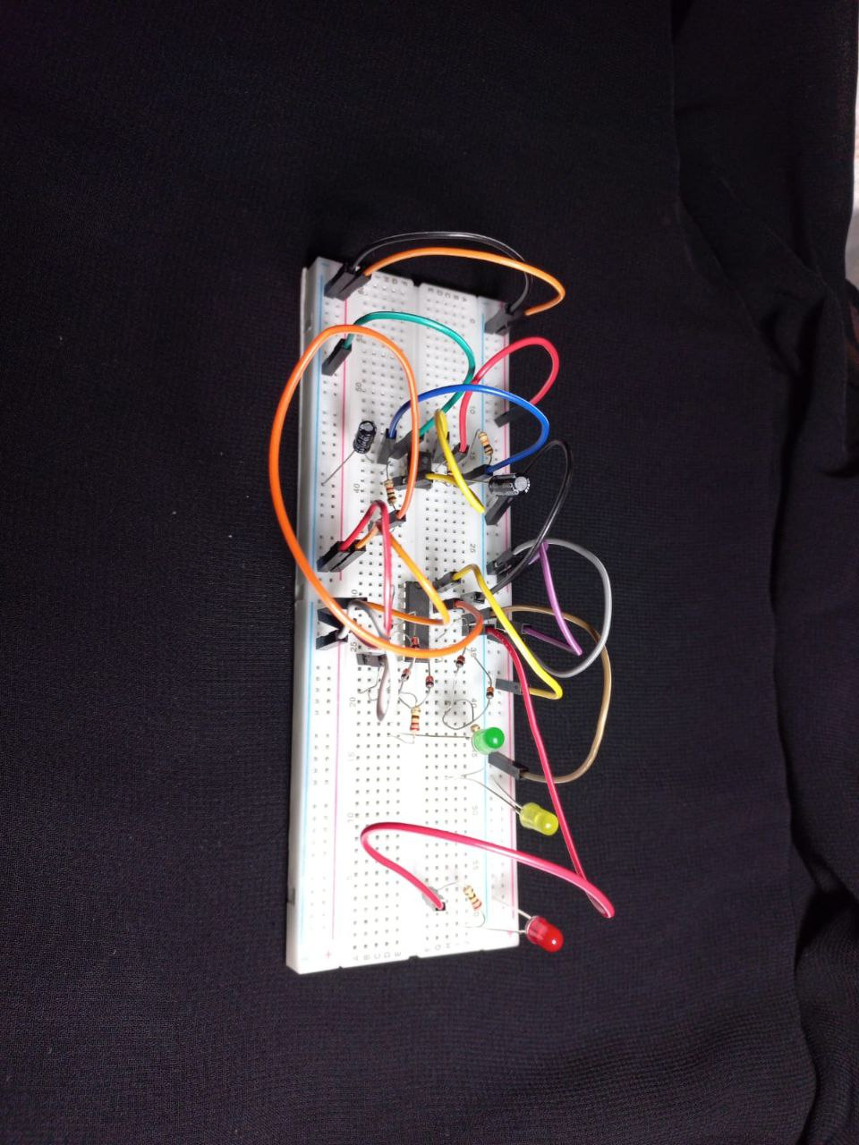
A single traffic light circuit
A single traffic light circuit uses a 555 timer for precise timing and a CD4017 for sequential light switching, allowing systematic control of red, yellow, and green phases in the traffic signal.

Slide 4
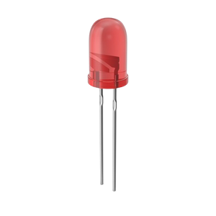
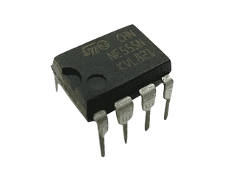
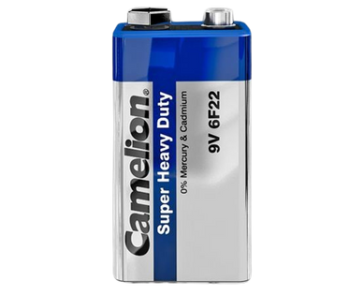
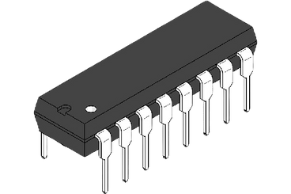
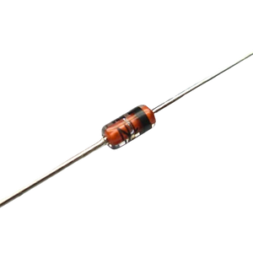
Circuit components
1- A timer 555
(pulse generator)
2- A 4017 counter
3- A 10uF capacitor
4- (6) 1N4148 Diodes:
current flow in one direction
5- 3 leds (red,green,yellow)
6- Battery 9v
7- 6 Resistors (220 , 10k , 100k)

Slide 5
Working
Counter recieves pulses generated by timer and sequentially activates its pins which are connected to our leds in the order in which a
traffic light works.
Each led has number of clocks to light up through.
We control led lighting time by controlling pulses:
T=0.694(R1+2R2)C
T=0.694(10k+2*100k)*10uF=1.45 S

Slide 6
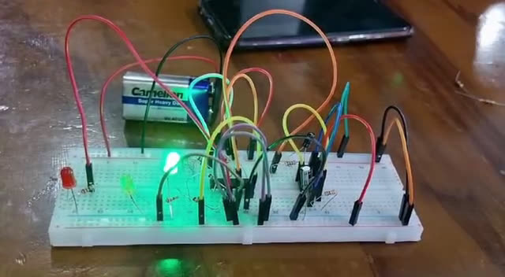
A single traffic light circuit

Slide 7
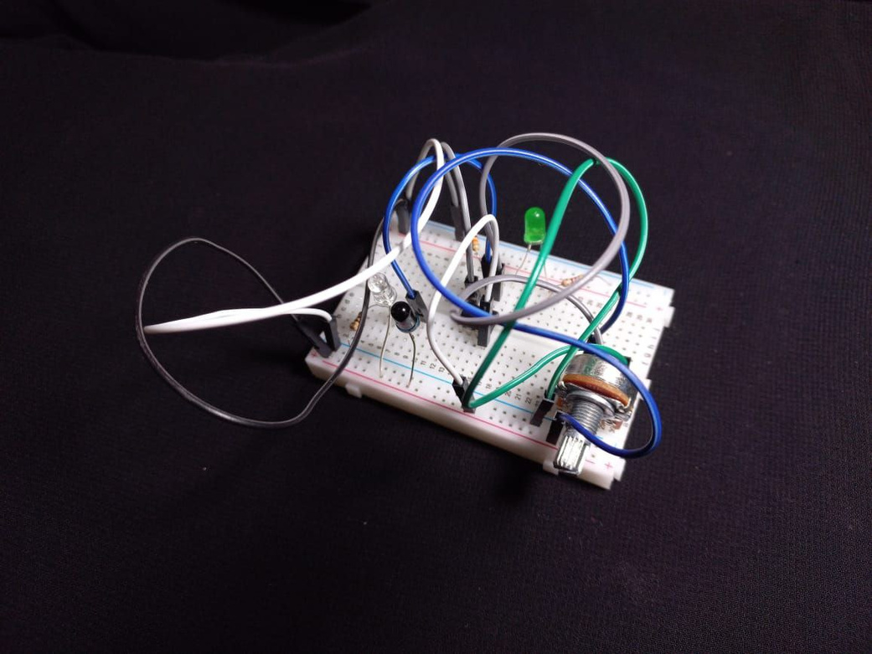
IR sensor module
An IR sensor module integrates a transmitter for sending controlled infrared signals and a receiver for detecting incoming signals, enabling applications such as remote controls and object detection.

Slide 8
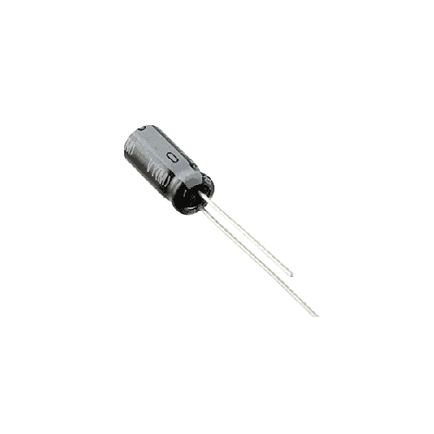
Circuit components
1- IR PhotoDiode pair
infrared light detection
2- A led
3- LM358 Comparator
compare sensor signal with reference voltage
4- 1K potentionmeter
controls reference voltage
5- Battery 9v
6- 3 resistors(100,220,10k)

Slide 9
working
When an object is near to IR sensor an infrared light is emitted by IR LED,it collides with the object and reflected to the photodiode, then current flows through the circuit.
Object is nearer, infrared light ,current flow and voltage .
LM358 compares voltage from IR (non inverting) and reference voltage(inverting).
led is ON whenever an object comes near to IR sensor

Slide 10
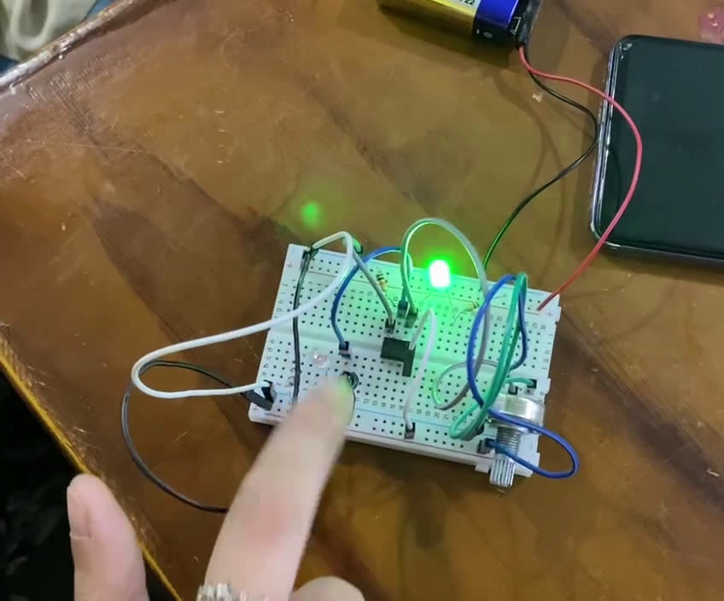
IR module

Slide 11
Team members
1-Hager Ahmed Mohamed
2-Hager Mohamed Sobhy
6-Ziad Ahraf Essa
3-Eman Atef Khodary
7-Ahmed Yasser
4-Tasneem Ashraf Elsayed
5-Islam Elsayed Mohamed

Slide 12


